Slide 1

Capstone Project-2 On Retail Sales Prediction
By:
Mohd Faisal Khaleeq
Mohd Kashan

Slide 2
PROBLEM STATEMENT
Rossmann operates over 3,000 drug stores in 7 European countries. Currently, Rossmann store managers are tasked with predicting their daily sales for up to six weeks in advance. Store sales are influenced by many factors, including promotions, competition, school and state holidays, seasonality, and locality. With thousands of individual managers predicting sales based on their unique circumstances, the accuracy of results can be quite varied.
You are provided with historical sales data for 1,115 Rossmann stores. The task is to forecast the "Sales" column for the test set. Note that some stores in the dataset were temporarily closed for refurbishment

Slide 3

project description
So we will divide our work flow into following steps.
Data Collection and Understanding
Data Cleaning and Manipulation
Exploratory Data Analysis(EDA)
Hypothesis Testing
Feature engineering and Data preprocessing
ML Model Implementation

Slide 4
Data Manipulation
Id - an Id that represents a (Store, Date) duple within the test set
Store - a unique Id for each store
Sales - the turnover for any given day (this is what you are predicting)
Customers - the number of customers on a given day
Open - an indicator for whether the store was open: 0 = closed, 1 = open
StateHoliday - indicates a state holiday. Normally all stores, with few exceptions, are closed on state holidays. Note that all schools are closed on public holidays and weekends. a = public holiday, b = Easter holiday, c = Christmas, 0 = None
SchoolHoliday - indicates if the (Store, Date) was affected by the closure of public schools
StoreType - differentiates between 4 different store models: a, b, c, d
Assortment - describes an assortment level: a = basic, b = extra, c = extended
CompetitionDistance - distance in meters to the nearest competitor store
CompetitionOpenSince[Month/Year] - gives the approximate year and month of the time the nearest competitor was opened
Promo - indicates whether a store is running a promo on that day
Promo2 - Promo2 is a continuing and consecutive promotion for some stores: 0 = store is not participating, 1 = store is participating
Promo2Since[Year/Week] - describes the year and calendar week when the store started participating in Promo2
PromoInterval - describes the consecutive intervals Promo2 is started, naming the months the promotion is started anew. E.g. "Feb,May,Aug,Nov" means each round starts in February, May, August, November of any given year for that store

Slide 5
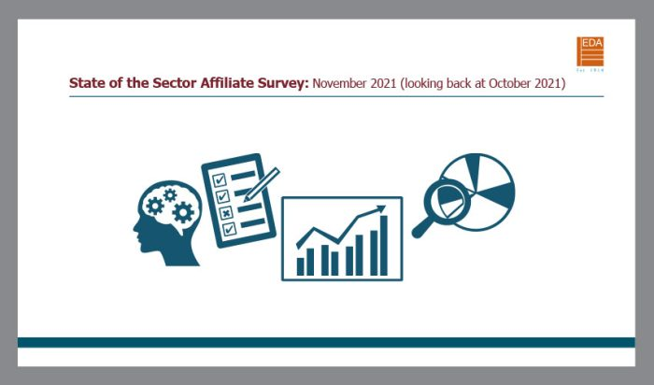
Exploratory Data Analysis(EDA)
EDA allows us to:
better understand the data
build an intution about the data
generate hypthesizes
find and study the insights

Slide 6
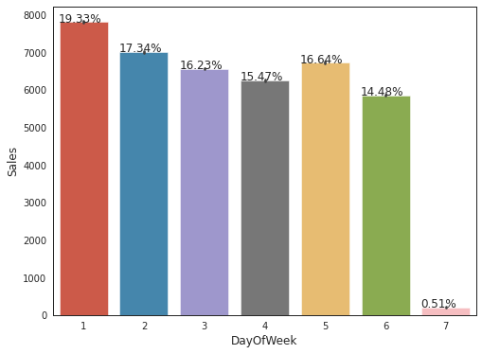
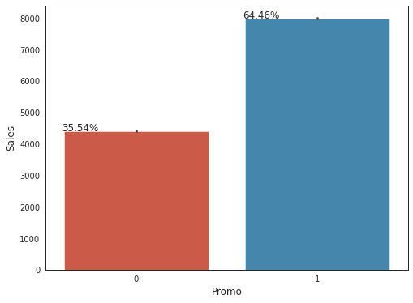
GRAPH
2
GRAPH
1
GRAPH 1 : day 1(monday) achieves highest sale in a week and day 7(sunday)achieves lowest or close to no sales.
GRAPH 2: In the case of promo, 1(participant) are more than the 0( non-participant) in the sales , which gives a positive and an effective signs for a profitable returns.

Slide 7
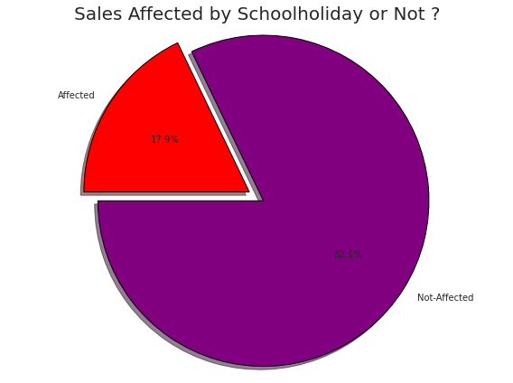
It is a good sign that the absence of the school functioning does not very much affects the sale ratios so the non affected is 82.1%
Holiday of the school somewhere marks a serious issue in the field of sales
As sales enhances the financial structure so every % matters .affected is 17.9%
Affected
Non Affected
Observations:
School Holiday plays a vital role in the increase and decrease in the sale in both the aspects
It is important to eliminate the dependence of the sales with respect to school holidays
Non affected Ratio marks a positive sign for the sales department as it is not very much affected with the holidays.

Slide 8
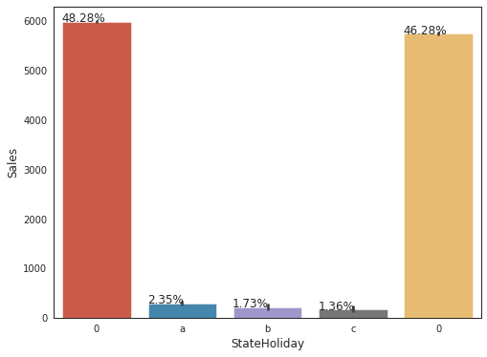
none
none
christmas
public holiday
easter
holidays
Observation at a glance:
State holiday with 0(none) affect the sales precisely
a(public holiday) does not very much affect the sales % and it is the most among the three differentials of the state holidays
b(easter holidays) by the name itself it is bounded by the events and dates which makes it limited and restrictive to carry more % in the sales proportion
c(christmas) as it is also only bounded to the event of christmas it also does not affect the sales very much but only give a breakthrough to the state holidays.
At last again with no public holiday it affect the sales accordingly.

Slide 9
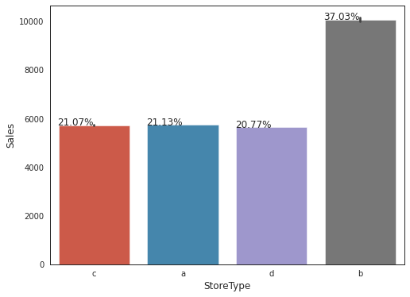
Observations:
a achieves it’s total sales of about 21.13% which is somewhat equal to both c and d which backs it to an average sale among the different store type
b achieves the highest sales among all the prescribed store type and proves to be the leading sales store type which constitutes of upto 37.03% of sales
c also achieves an average sales among a and d which is about 21.07% and is concerned to be more developing
d has the lowest or the minimum sales ratio among all the store type but somewhat average to a and c

Slide 10
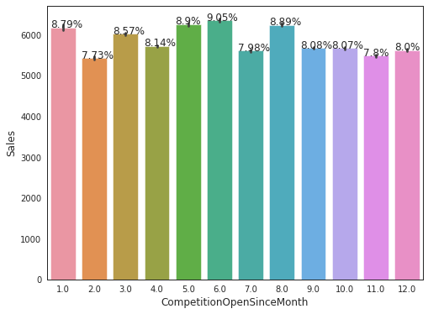
Observation:
As given on the x axis are the given months and on the y axis is given the magnitude of the sales with respect to the given months:-
The first month shows the competition among the different type were in presence with a % of 8.79 and it shows that the competition would be tougher as we carry forward
As we follow on with the passing months we assume that the competition is still in action with the coming months and till the time it is the sixth it records it highest competition among all
And till the end of the year it continues to dominate the market by a continuous competition
So in a summarized assumption , it is noticed that the sales among different store type proves to more competitive and futuristic.

Slide 11
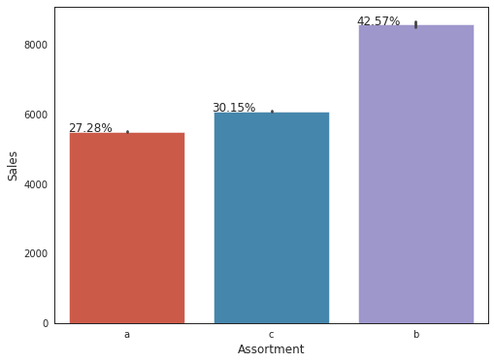
Observation:
a level of assortment (basic) constitutes to about 27.28% of sales which is lowest among the different levels but it can be taken up by many small stores
c level(extended) gives almost 30% of the total sales among the levels of assortment and it can be also opt as an option to enhance the effectiveness and overall performance
b level of assortment (extra) dominate the overall share of the assortment type by almost 42% and proves to be the most preferred and worthy among all the levels .

Slide 12
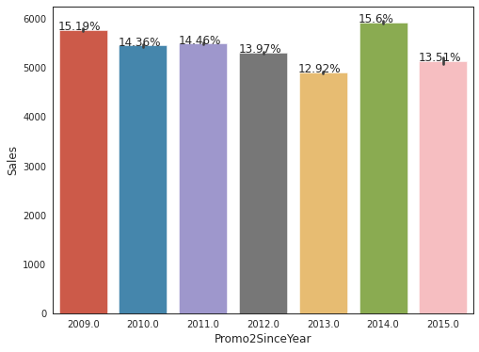
Observations of the following graph:
i. Starting from 2009 ie,sales were 15.19% which further shows a downward trend till 2013 reaches down at 12.92% with the respected promo2 among several years
ii. In the year 2014 it showed a remarkable increase to 15.6% which is the highest among all the years which prove to be revival comeback for the promo2
iii. In the year 2015 it again decreases to 13.51% which concludes that the sales in the promo2 experiences an intense and irregular competitions.

Slide 13
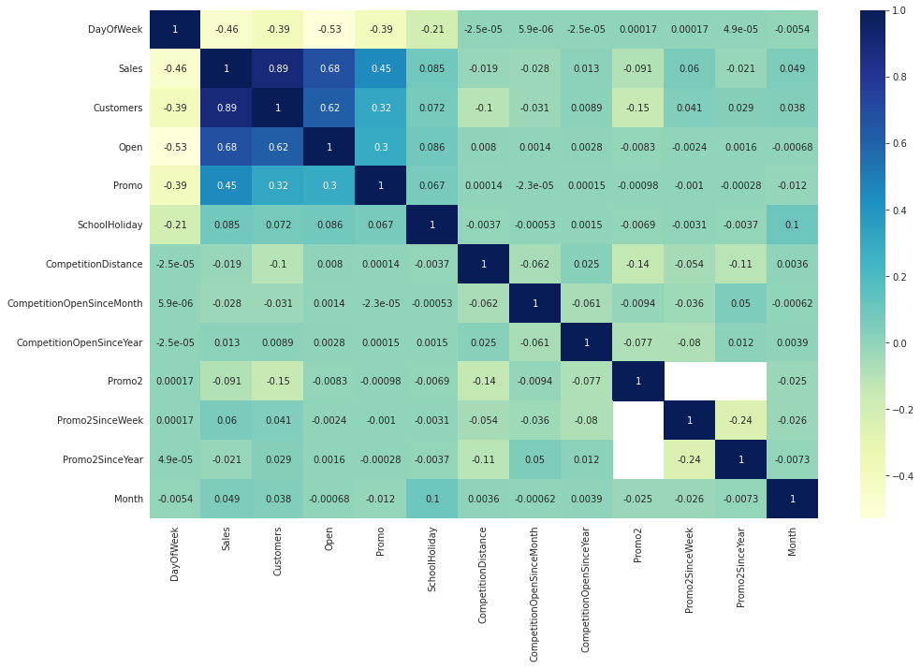
CORRELAT ION
MATR IX

Slide 14
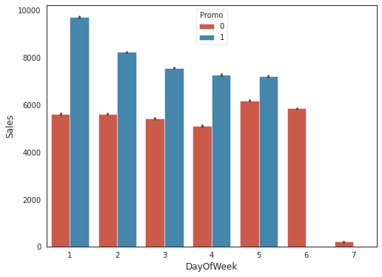
Observation:
With respect to the consideration of both the promos :
With respect to promo 0 is the analysis where the store is participating of not so we can predict that promo0 is always less than promo 1 throughout the week and also active on the 7th day as well
While in case of Promo 1 it is clearly mentioned that it starts it’s week with the apex, and end with no sales on the last day of the week
it shows a downward trend throughout the week but is always greater than promo 0 and thus it is leading the sales through the week

Slide 15
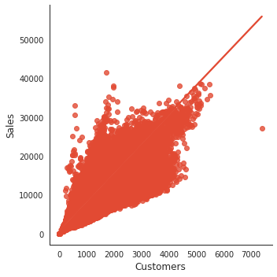
Observation:
As shown in the above model it is clearly showing a direct relationship between the number of customers and the given sales.
As the customer increases the sales also increases, and as the number of customer are less the sales also reduces.
It can be predicted that direct trend often leads to a crucial role payer in the functioning of an effective start and end as well.

Slide 16
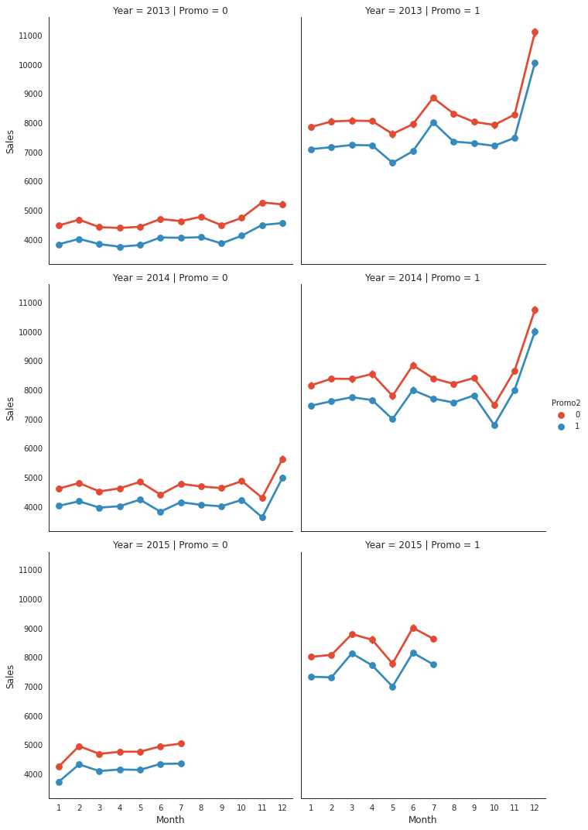
1.Here we can see that if their is no promo the sales is very less and if promo running their the sales is high.

Slide 17
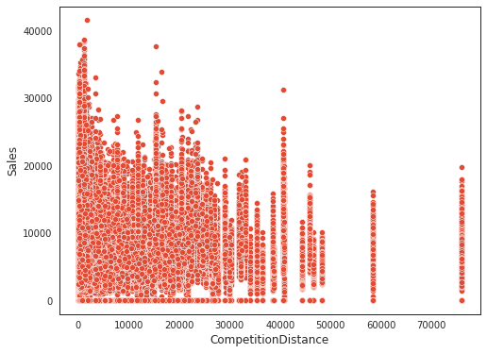
Hypothesis Testing (Consideration)
As shown in the above :
The closer is the competition distance the higher is the sales, the more far you are from the field or the range of competition less or no sales is experienced.
It is equally important that the sales is enhanced and chased by the competition it seeks, so the more the competition the more is the sales
As in the case of 10000 we can clearly analyze that the sale is the most, but while it covers more distance at 30000 the sales gradually decreases and at last 70000 it is zero or less sales.

Slide 18
FEATURE
ENGINEERING

Slide 19
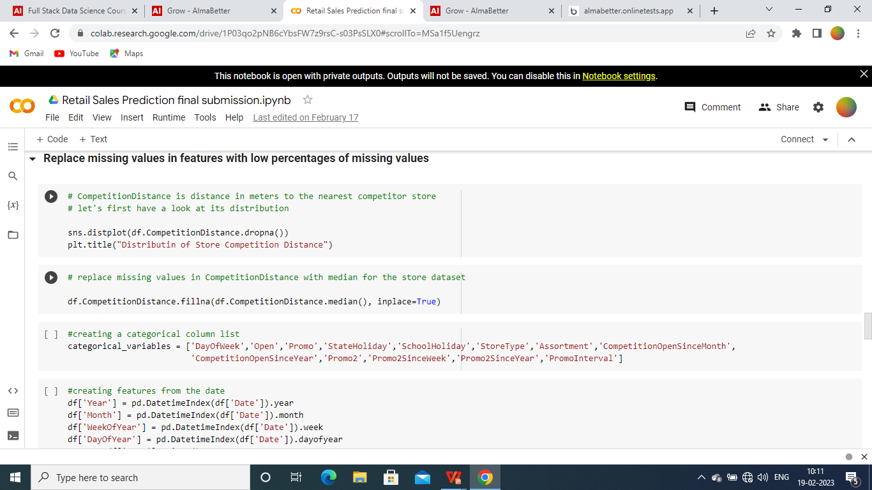
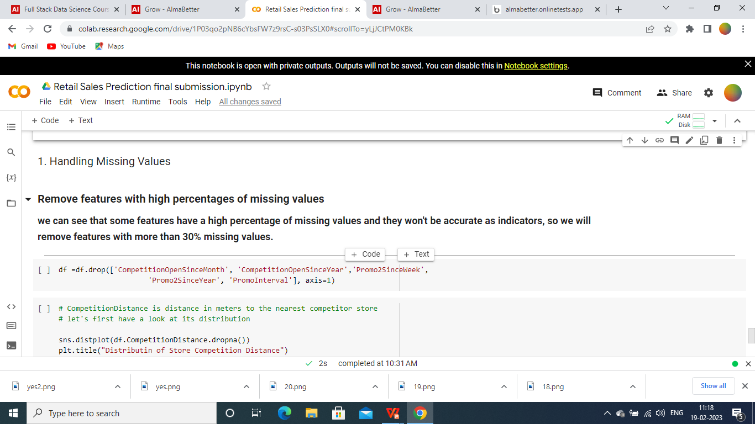
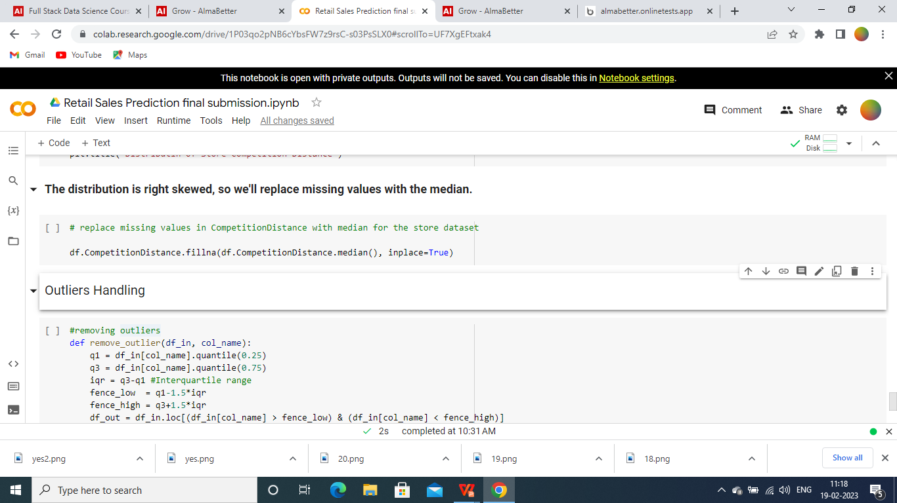

Slide 20
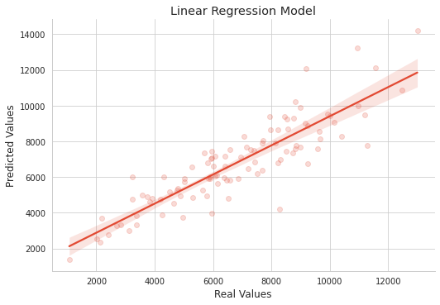
ML Model Implementation

Slide 21
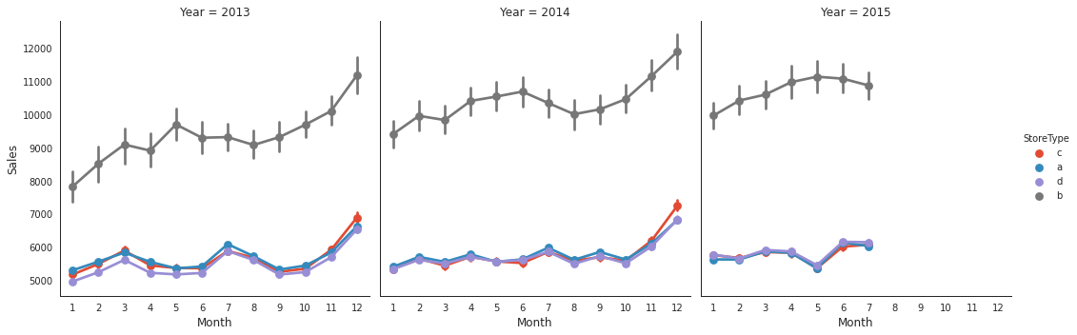

Slide 22

EDA(Observations)
More number of participant (promo 1) and sale is at apex on monday
School and state both holidays does not affect the sales effectively which shows a positive sign for the sales department to carry on..
Among all the stores there is an intense competition throughout the several years and among all different stores (b)store type achieves the highest sales among all the stores and proving to be futuristic and attentive
Among different assortment levels b(extra) type also provides the highest share in the assortment levels.
With Promo2, slightly more sales were seen without it which indicates there are many stores not participating in promo.
In the promo2 it was seen that it had an intense competition throughout the years
Correlation Matrix shows both positive and negative approaches with relate to one and another factors.
Feature Engineering (Observations)
The MSE and R2 score are commonly used evaluation metrics for regression models. In this case, the Linear Regression and Lasso Regression models have very similar performance, with the Lasso Regression model having a slightly lower MSE and a slightly higher R2 score.
The mean squared error (MSE) measures the average squared difference between the predicted and actual values, where a lower MSE indicates better performance. The R-squared (R2) score measures the proportion of the variance in the dependent variable that is predictable from the independent variables, where a higher R2 score indicates better performance.

Slide 23


